Slide 1
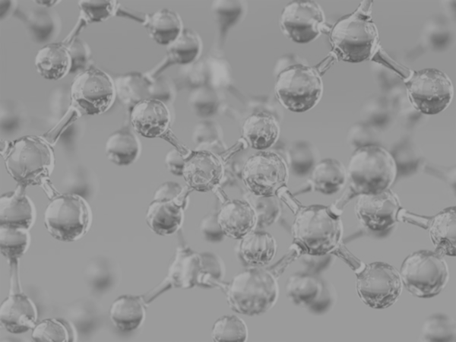


Concrete Strength Prediction
Keng Ming Cheng
University of California, Los Angeles (UCLA)
Contact: kengming_cheng@outlook.com
Physics of AmoRphous and
Inorganic Solids Laboratory

Slide 2
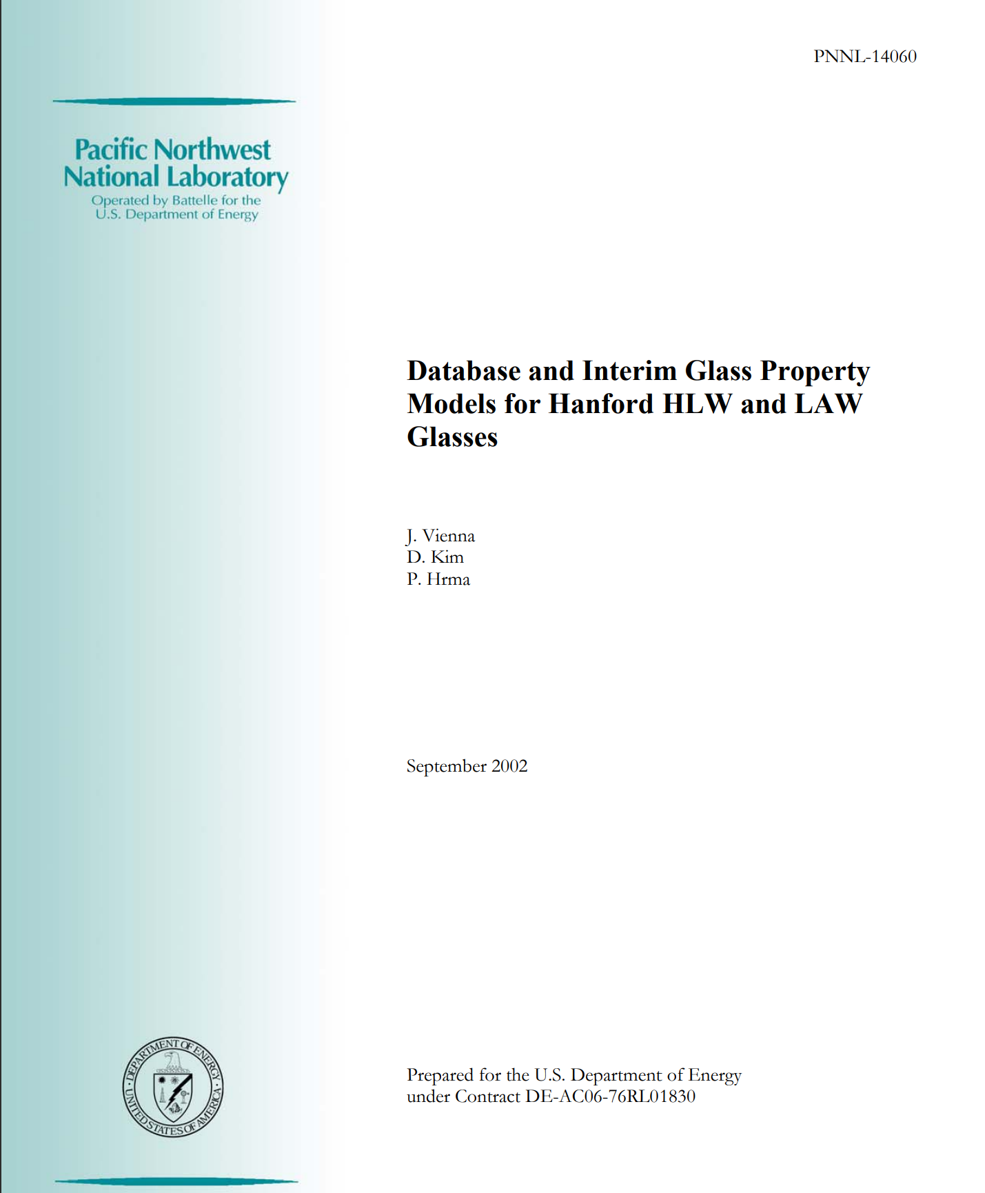
Results
Extract Glass Data

Slide 3
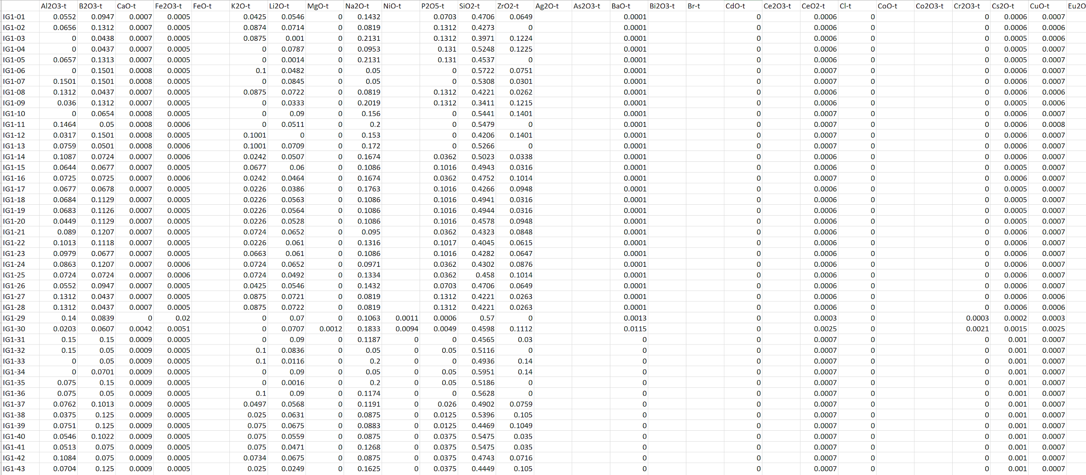
Results
Glass Data
https://tabula.technology/

Slide 4
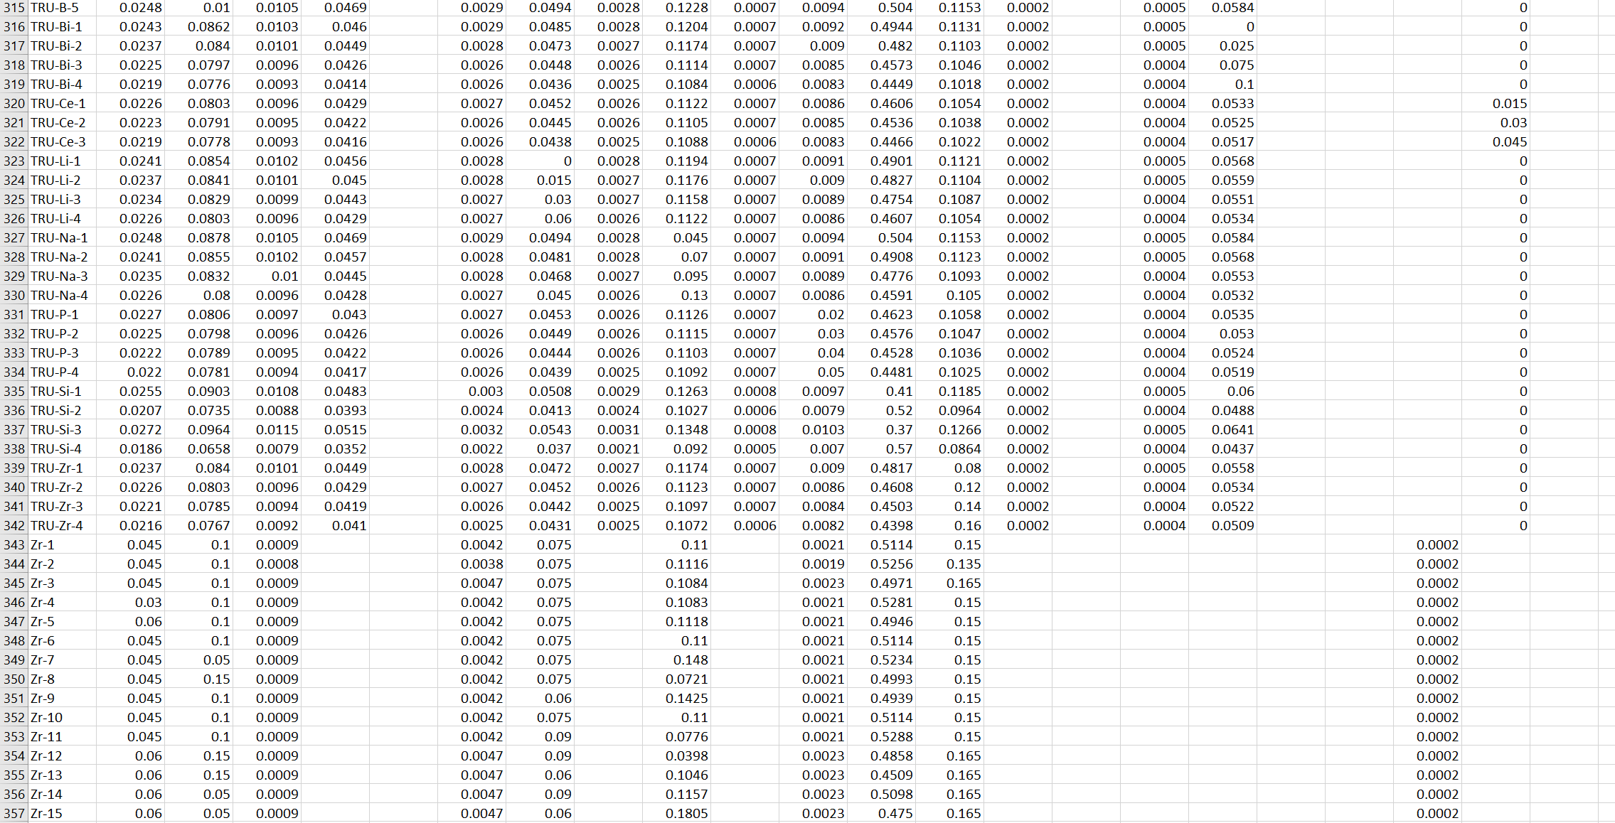
Results
Glass Data
https://tabula.technology/

Slide 5
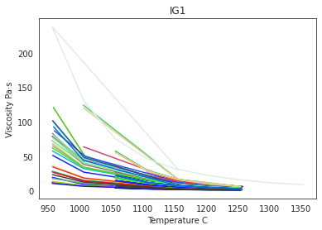
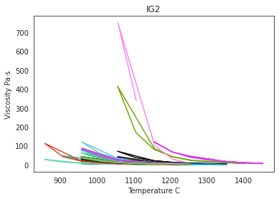
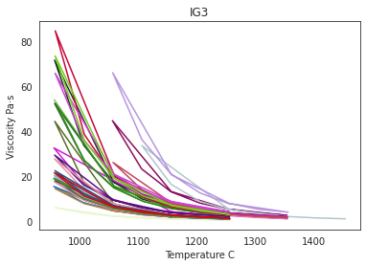
Results
Glass Data - IG
https://tabula.technology/

Slide 6
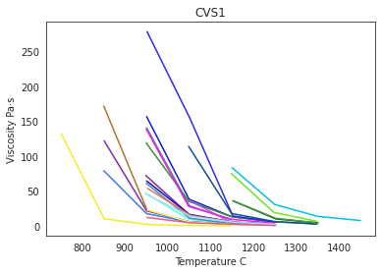
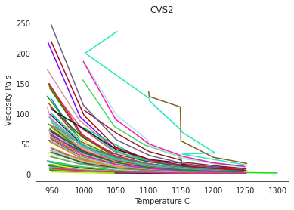
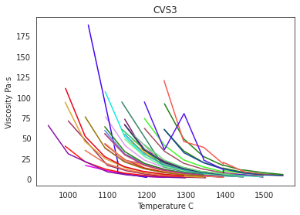
Results
Glass Data - CVS
https://tabula.technology/

Slide 7
Searching Optimal Value Based on Trained model

Slide 8
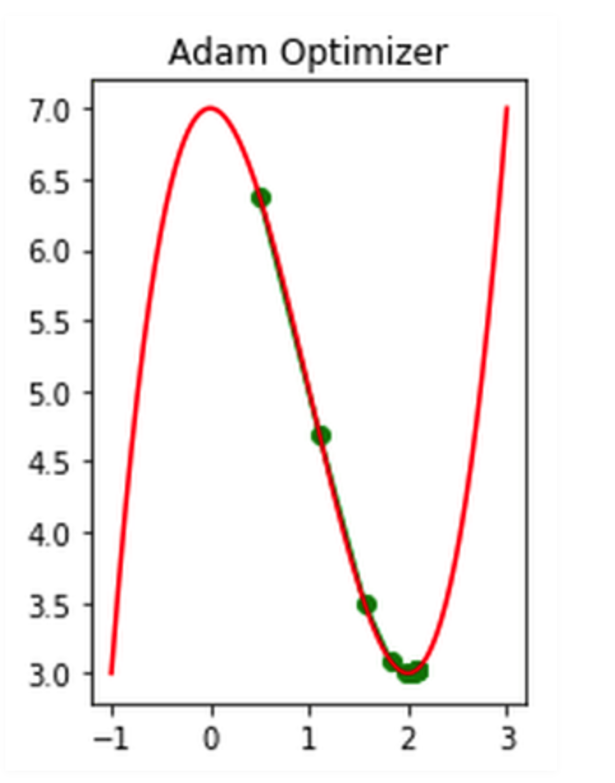
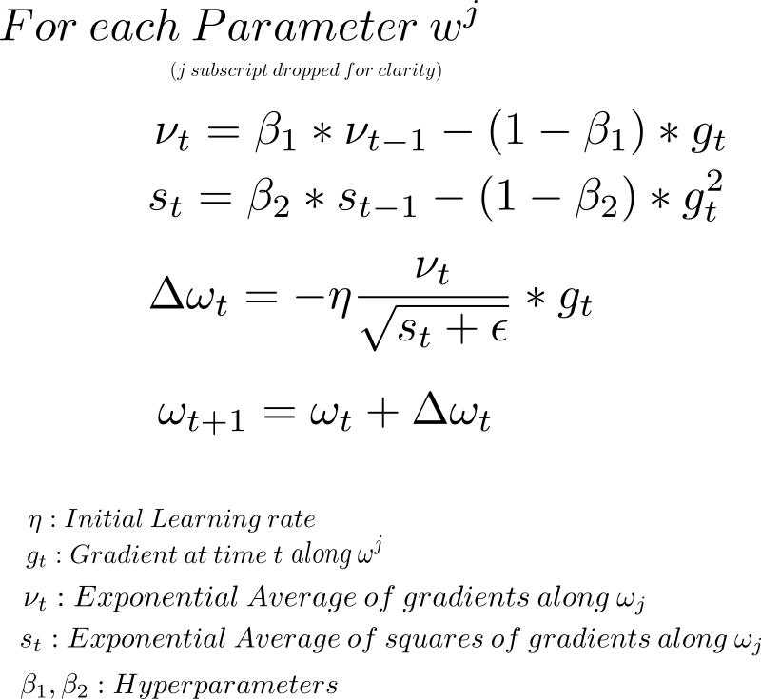
Results
Searching Optimal Value
Using optimizer to approach the global minimum of strength per cost
cost = Sum of input features
Loss = - (Predicted strength) / (Sum of input features)
Use Adam optimizer to get minimum regarding to Loss
opt = tf.keras.optimizers.Adam(learning_rate=0.01)
loss_fn = lambda: tf.constant(-1.0) * (nn_model(var1)*target_scaler.scale_[0]+target_scaler.mean_[0]) * 0.00689476 / tf.reduce_sum(var1*input_scaler.scale_+input_scaler.mean_)
for _ in range(500):
opt.minimize(loss_fn, [var1])

Slide 9
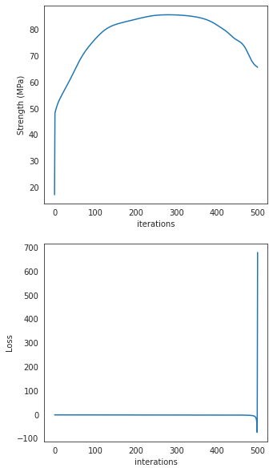
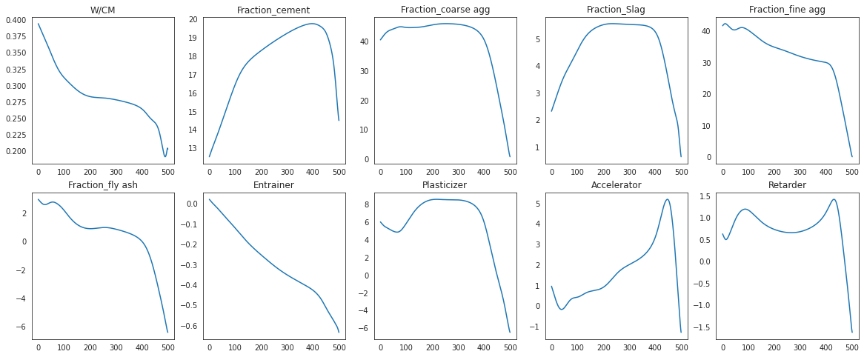
Results
Searching Optimal Value
cost = Sum of input features
Loss = - (Predicted strength) / (Sum of input features)
Use Adam optimizer to get minimum regarding to Loss

Slide 10
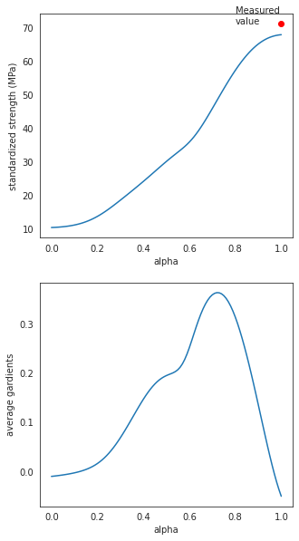
Results
Searching Optimal Value
Integrated Gradients
alpha = 0 represent the values of baseline
alpha = 1 represent the values closed to optimal values
alpha =0 → alpha = 1 searching the path where the optimal values may exist
def compute_gradients(datas,target_class_idx = 0):
with tf.GradientTape() as tape:
tape.watch(datas)
logit = nn_model(datas)
probs = logit
return tape.gradient(probs, datas)
def integral_approximation(gradients):
# riemann_trapezoidal
grads = (gradients[:-1] + gradients[1:]) / tf.constant(2.0)
integrated_gradients = tf.math.reduce_mean(grads, axis=0)
return integrated_gradients
def gradients_for_regression(baseline, data,m_steps=100,batch_size=32,show_measured_data=True):
alphas = tf.linspace(start=0.0, stop=1.0, num=m_steps+1)
interpolated_data = interpolate_datas(baseline, data, alphas)
path_gradients = compute_gradients(datas = interpolated_data)
prediction = nn_model(interpolated_data)

Slide 11
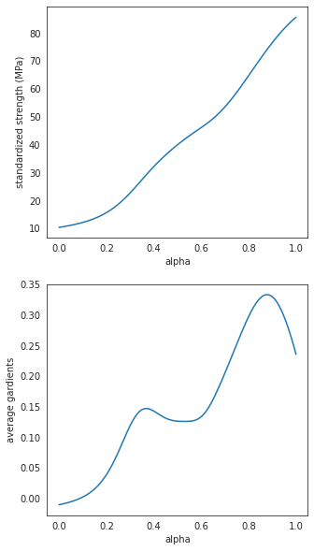
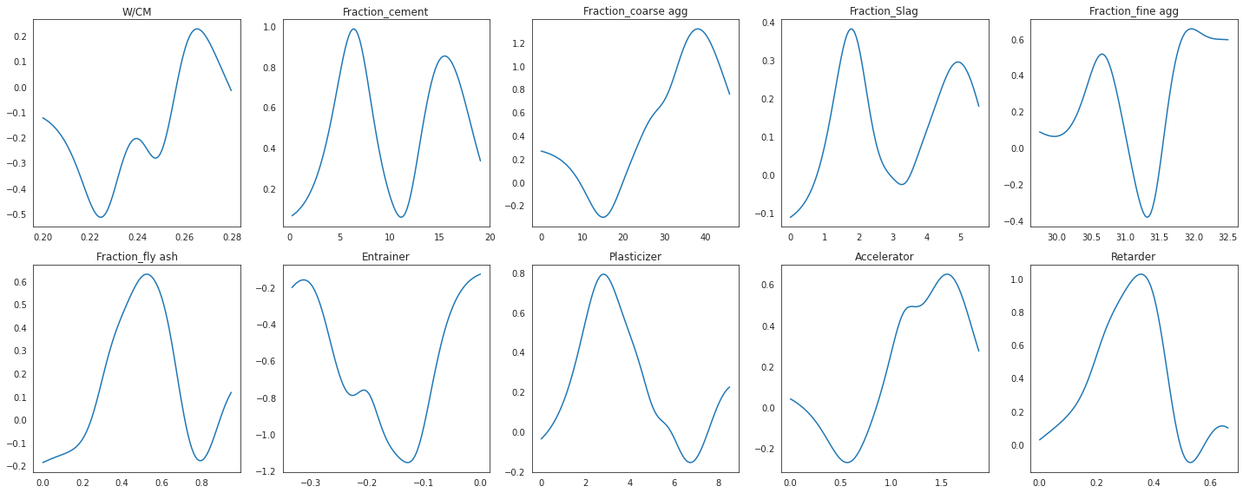
Results
Searching Optimal Value

Slide 12

Notes:
Thank sponsors

Slide 13
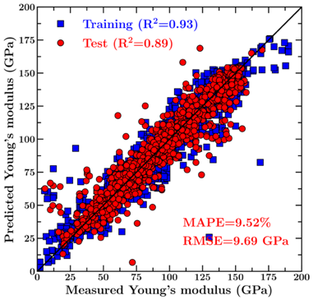
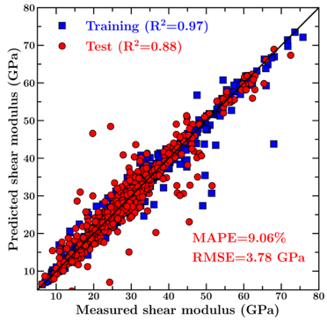
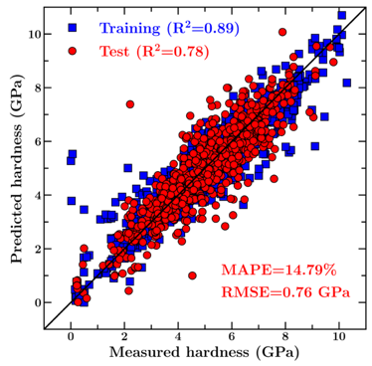
Results
Prediction of Concrete Mechanical Properties
Young’s modulus
Shear modulus
Hardness
> Our model offers a very good prediction of the mechanical properties of test set glasses (which are kept invisible to the model during its training).

